Slide 1









Apollo Hospitals
Hospital Management System
Presented By:
Aishwarya R

Slide 2



Apollo Hospitals
Introduction
The Hospital Management System (HMS) is a comprehensive digital solution designed to manage the day-to-day operations of a hospital efficiently.
It handles patient records, appointments, departmental functions, and doctor allocations in an organized manner.
This system improves accuracy, reduces paperwork, and enhances patient care and administrative productivity.

Slide 3




Apollo Hospitals
Tools used
Excel
My SQL

Slide 4


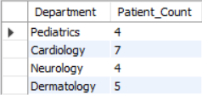


Apollo Hospitals
1.How many patients belong to each department?

Slide 5


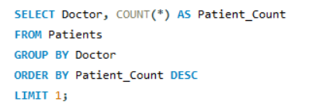
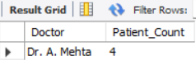

Apollo Hospitals
2.Which doctor has the highest number of patients?

Slide 6






Apollo Hospitals
3.List the names and ages of all female patients older than 50.

Slide 7


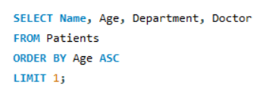
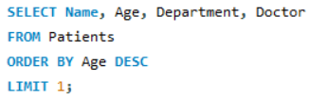

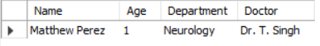
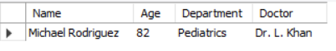
Apollo Hospitals
4.Find the youngest and oldest patient along with their doctor and department.

Slide 8


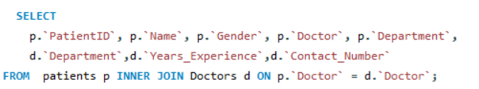
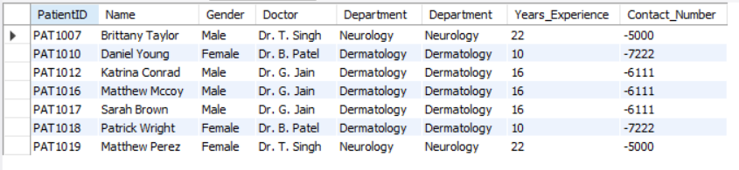

Apollo Hospitals
5.Write a SQL query to display the following details of patients along with their assigned doctor’s experience and contact number:

Slide 9



Apollo Hospitals
Conclusion
The Hospital Management System significantly enhances operational efficiency and data accuracy across healthcare functions. It ensures streamlined workflows, informed decision-making, and improved patient care delivery.

Slide 10



Apollo Hospitals
Thank You

